Slide 1

Lending Loan Case Study
Group Members
Astha Agarwal Vinay Prasad K

Slide 2
AGENDA
Overview- Problem Statement​
Methodology
Data Transformation – Cleaning and imputation
Exploratory Data Analysis
Univariate Analysis
Bivariate Analysis
Multivariate Analysis
​Summary​

Slide 3
Overview
About Company : Lending Club is the largest online loan marketplace, facilitating personal loans, business loans, and financing of medical procedures. Borrowers can easily access lower interest rate loans through a fast online interface.
Problem Statement: Analyze data to identify
Driving factors behind loan default, i.e. the variables which are strong indicators of default.
Consumer attributes and loan attributes that influence the tendency of default.

Slide 4
Methodology
Data Cleaning
Bivariate Analysis
Multivariate Analysis
Derived Column
Univariate Analysis
Conclusion

Slide 5




Data Exploration and Data Transformation

Slide 6
Data Cleaning
Dropping fields with all NA values
Remove fields not adding valuable meaning to problem statement from domain standpoint
Remove post approval features (features which will not impact the defaulting nature of borrower)

Slide 7
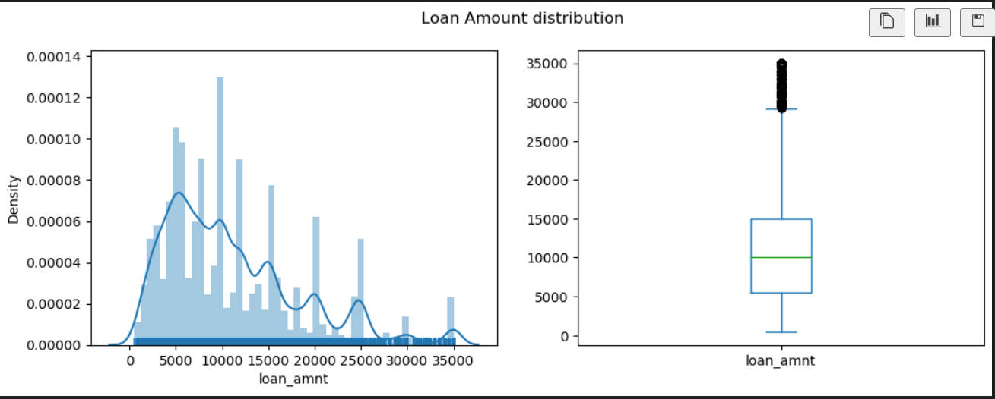
Data Analysis
Analyze content of categorical columns and numerical columns and clean if needed
Covert values to proper int ,float and date representations
Check for outliers
Observation: Most people have taken loan of around 10K as median and mean both are around same value. Maximum people have taken a loan of less than 25K as it is the 95th percentile of data distribution, after that only few people have taken loan in range of 25K to 35K

Slide 8
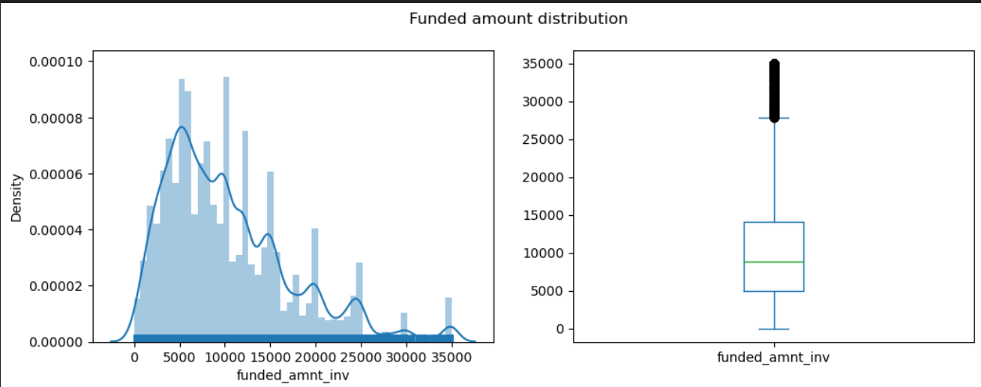
Observation: Most people have taken loan of around 10K as median and mean both are around same value. Maximum people have taken a loan of less than 25K as it is the 95th percentile of data distribution, after that only few people have taken loan in range of 25K to 35K

Slide 9
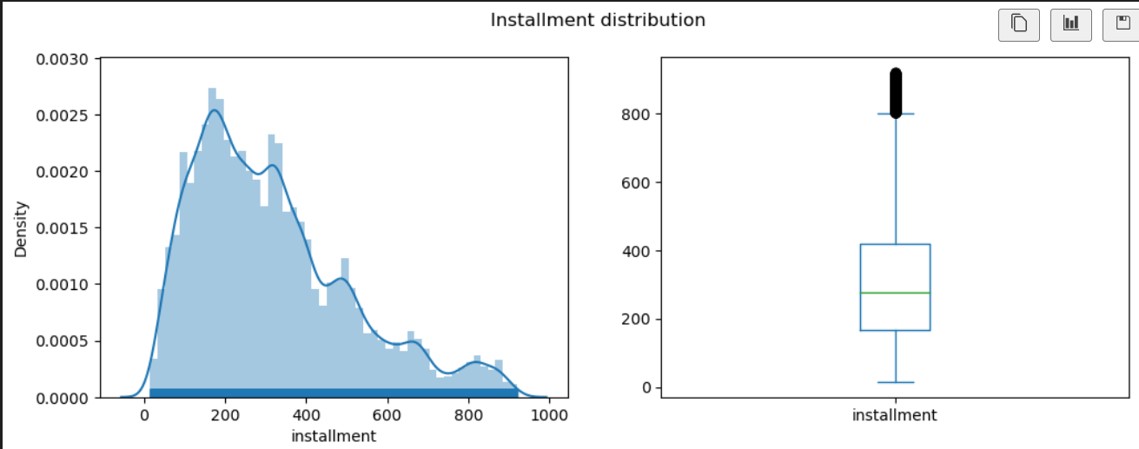
Observation: Installment distribution is static after 921 of value, 99 percentile is at 921 and for 1 percentile people installment is more than that. As per analysis , this is for people who applied for a loan of more than 25000. We can drop the outliers for installment

Slide 10
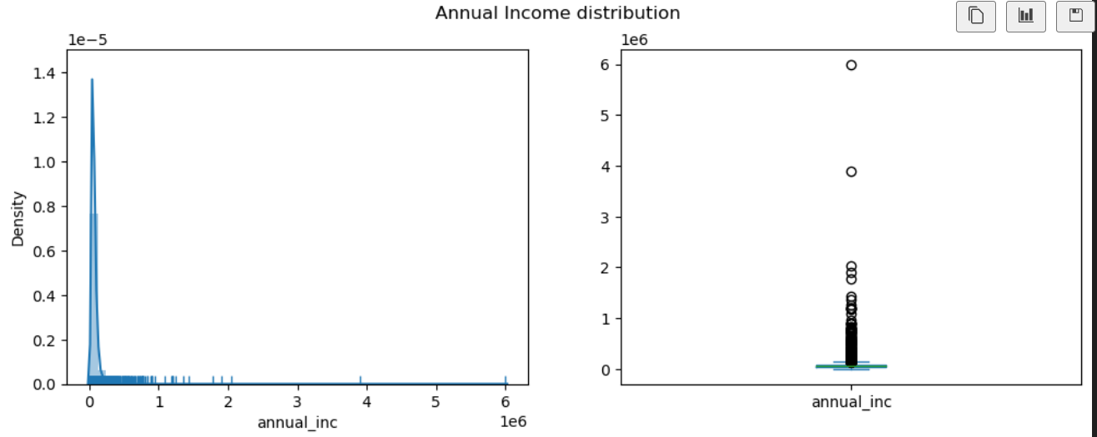
Observation: There are a lot of outliers in annual income field, 99 percentile customers have annual income below 235K and rest are outliers and we can skip from data

Slide 11
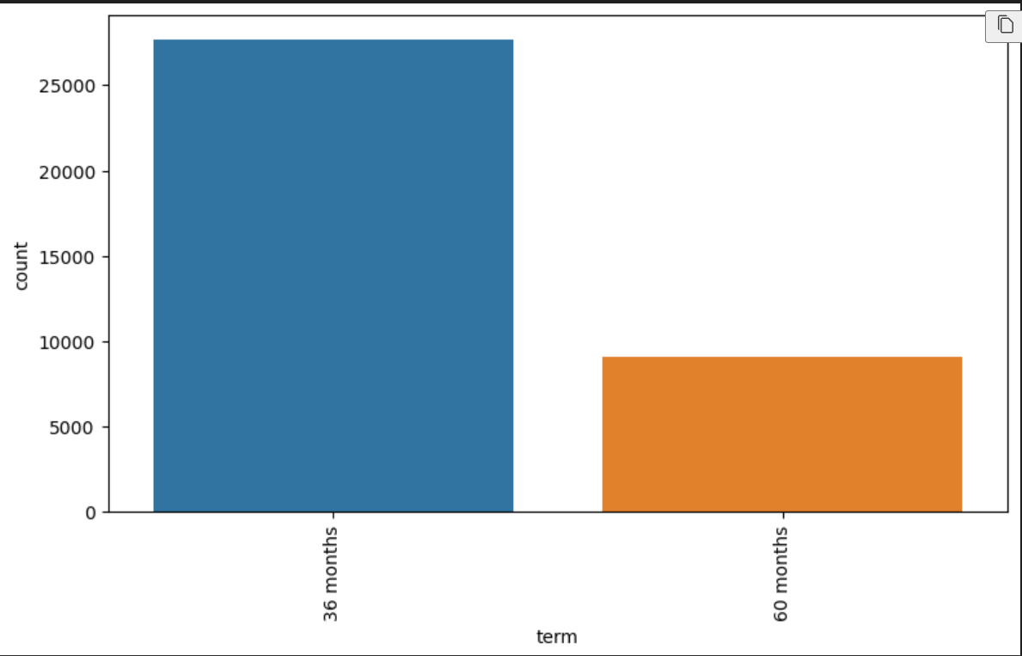
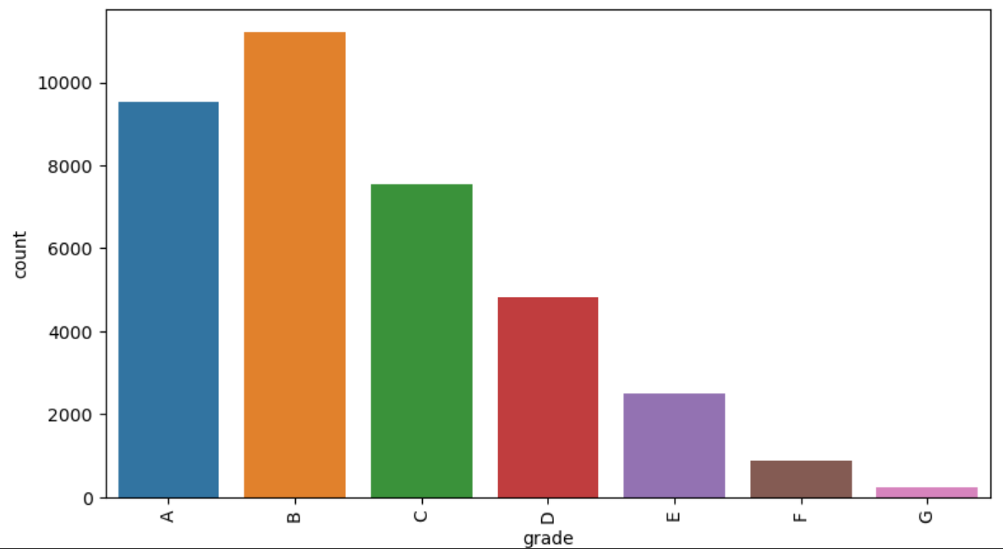
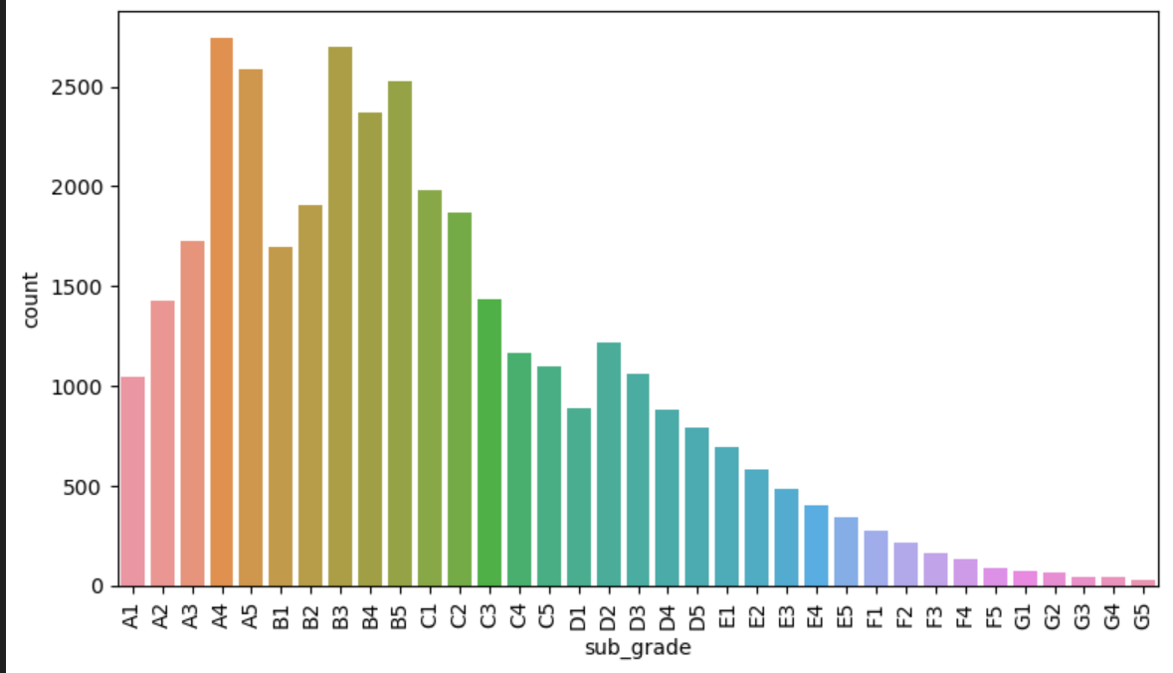
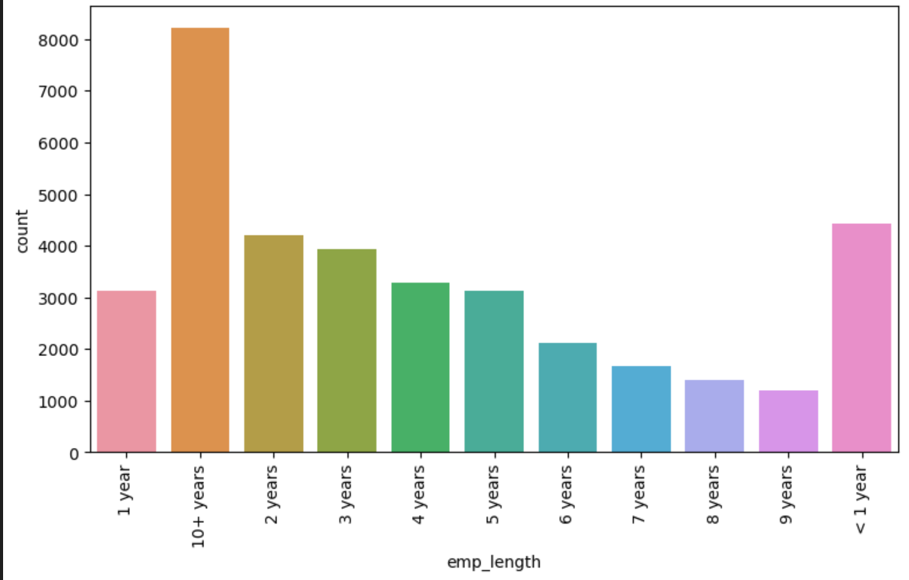
UniVariate ANalysis

Slide 12
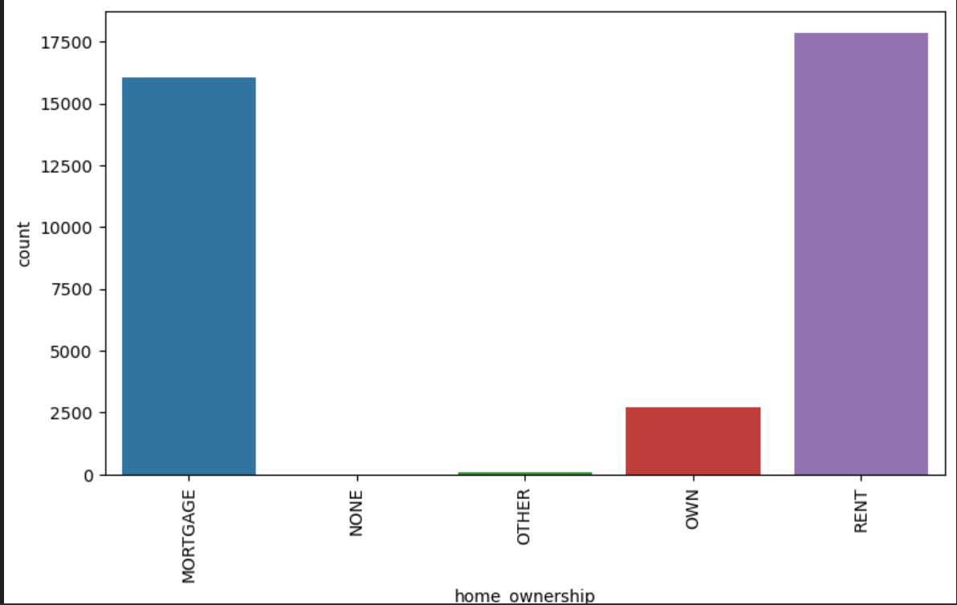
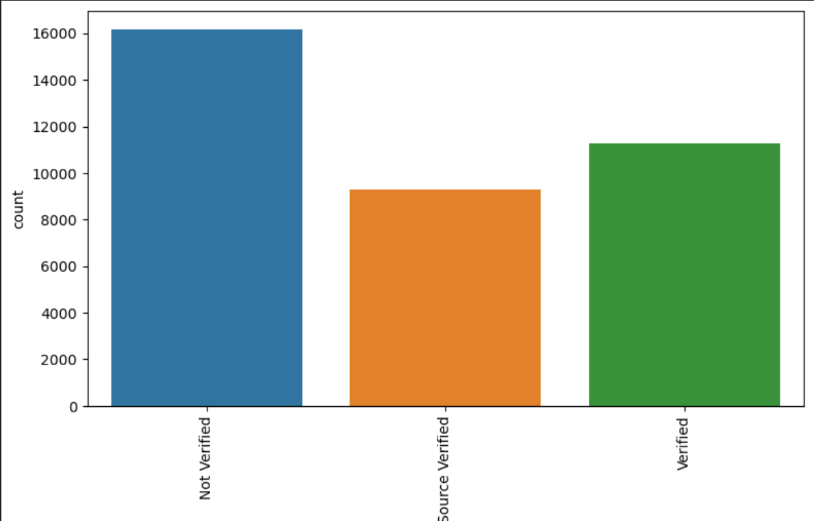
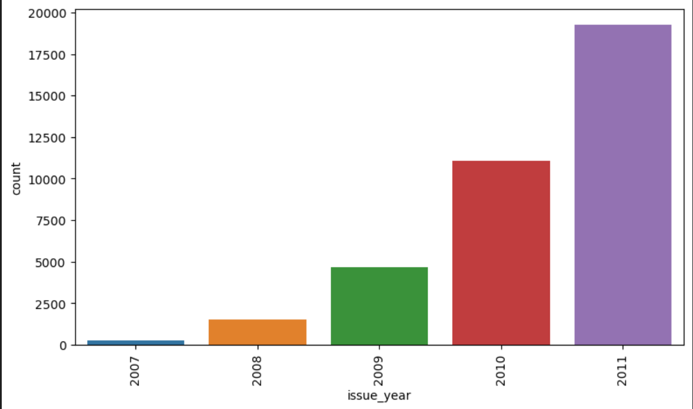
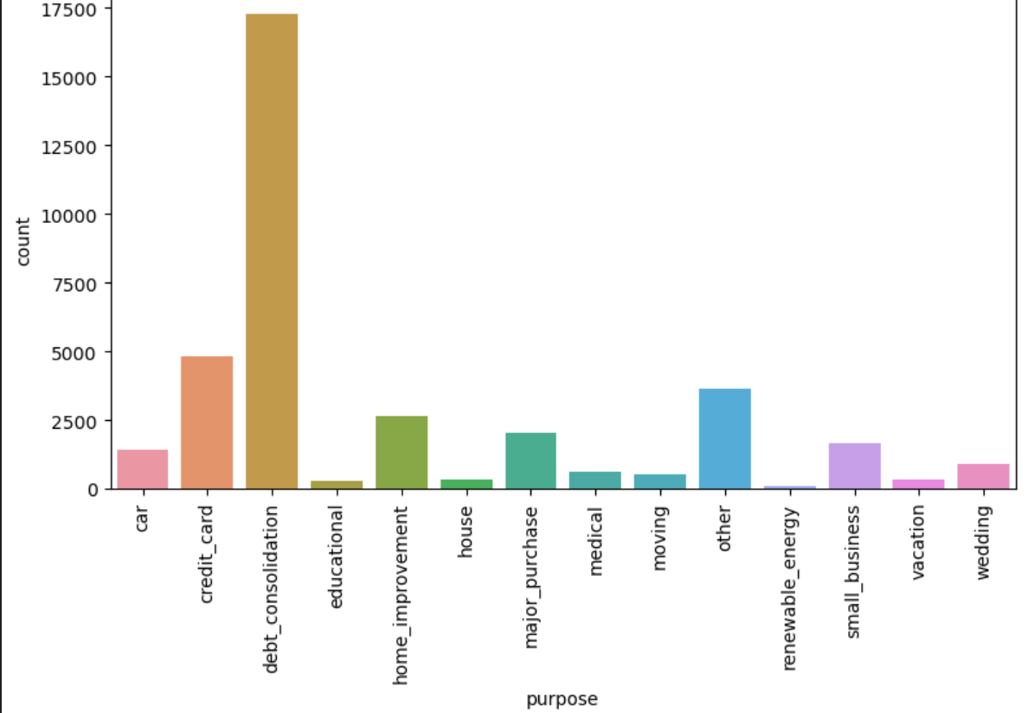
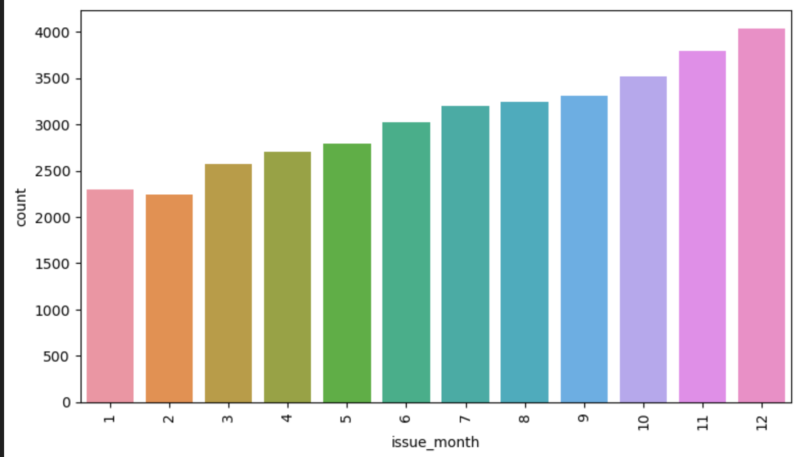

Slide 13
Observations
1. Borrowers are taking more loans in 36months term duration
2. Most of the borrowers are in A, B and C grade category and very few people in EFG grades.
3. Subgrade shows the similar distribution trend as grades, grade segments borrowers based on behaviors, hence we can exclude sub grade column
4. Maximum number of loans are taken by people who have been employed for more than 10 years
5. People who have either rented out property or have mortgaged their home have high chances of taking a loan
6. Most of the people are taking loan for debt consolidation
7. Most of the loans were issues in 2011,and number of loan applications are increasing every year
8. Most of the people generally take loans towards the end of the year

Slide 14
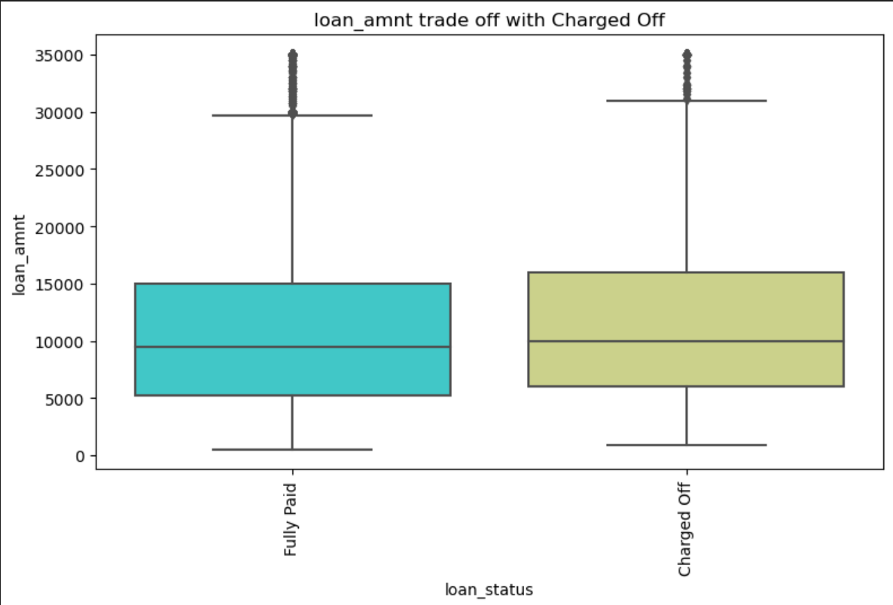
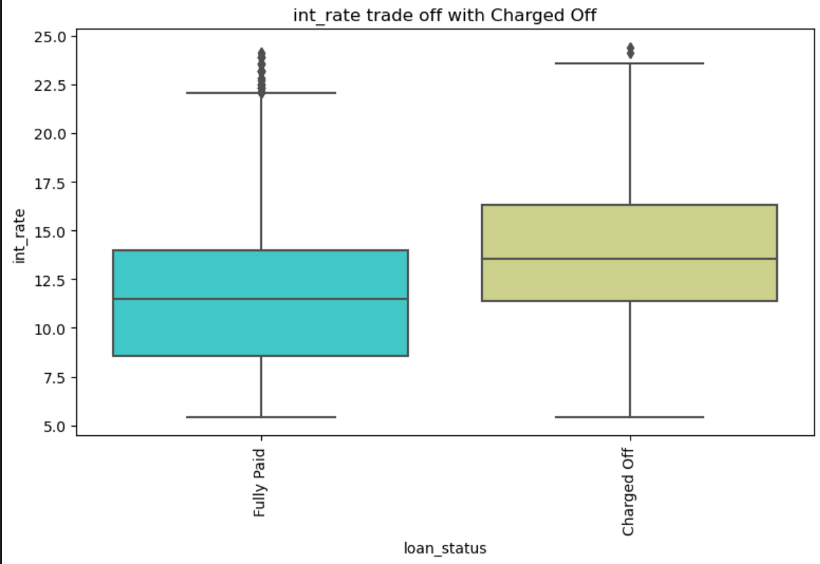
Bivariate Analysis
Observations:
1.Charged Off loans have higher amounts than Fully Paid ones.
2. This Chart clearly potrays, higher the interest rate more are the chance of Defaulting the loan.

Slide 15
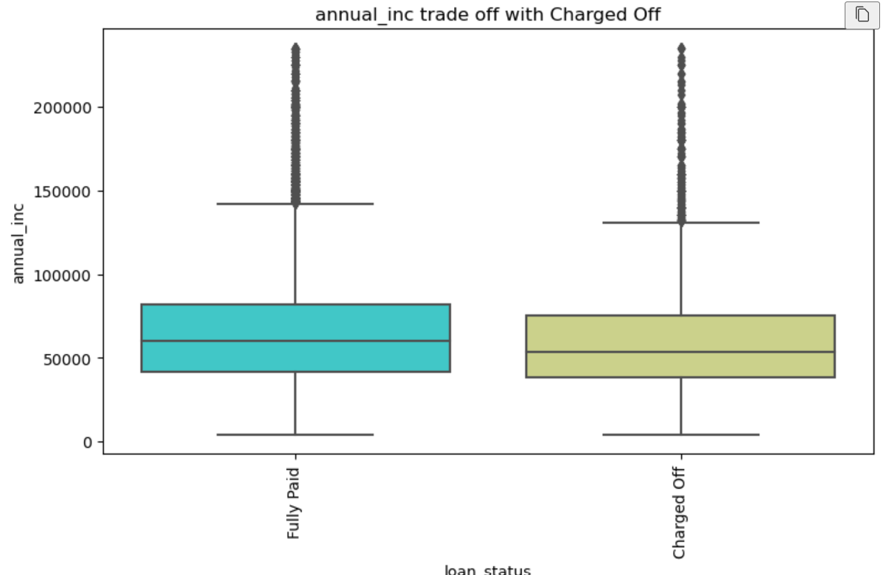
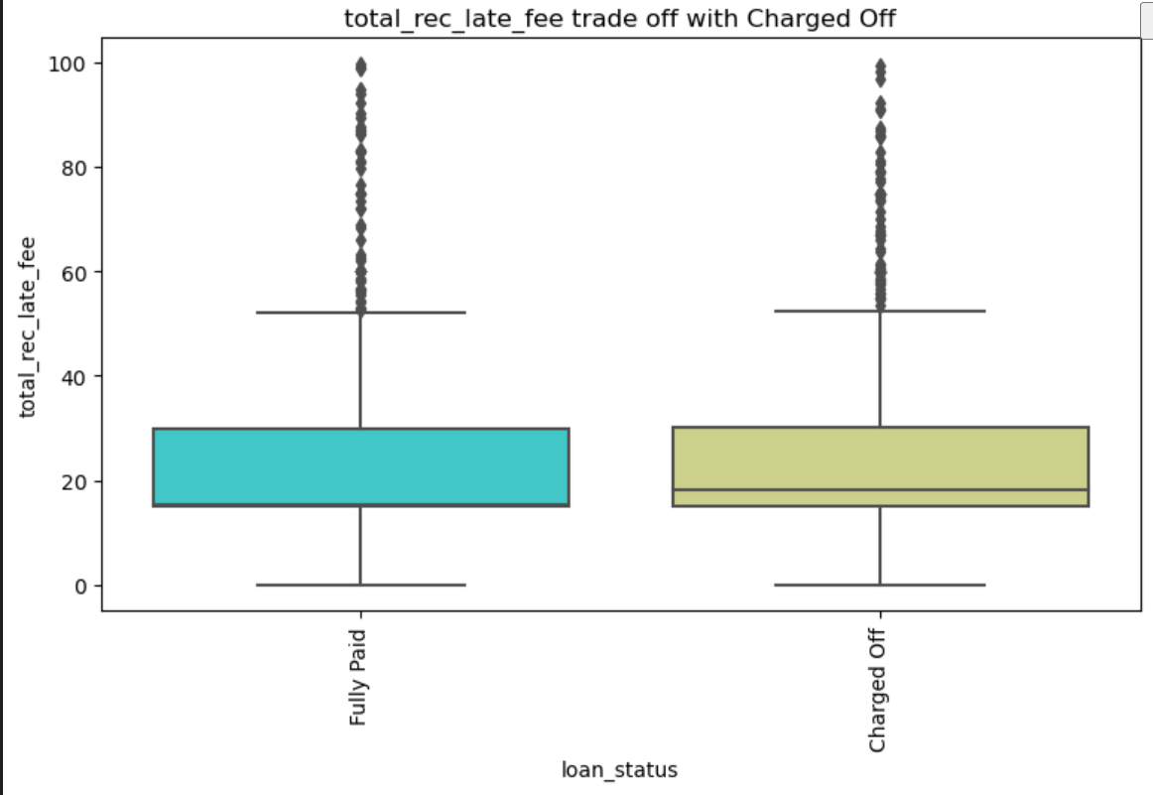
Observation:
1.Annual Income of the people marked Charged off is less than people whose loan is fully paid
2.People paying more late fees are more likely to default, as shown by the median, in case of Fully Paid its more towards 25th percentile, however it is towards center for Charged off

Slide 16
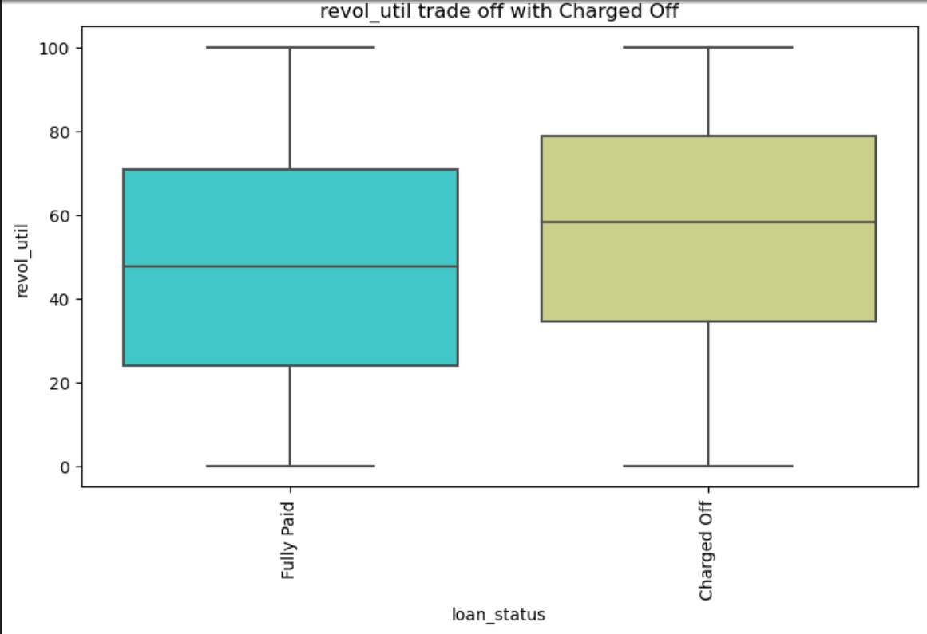
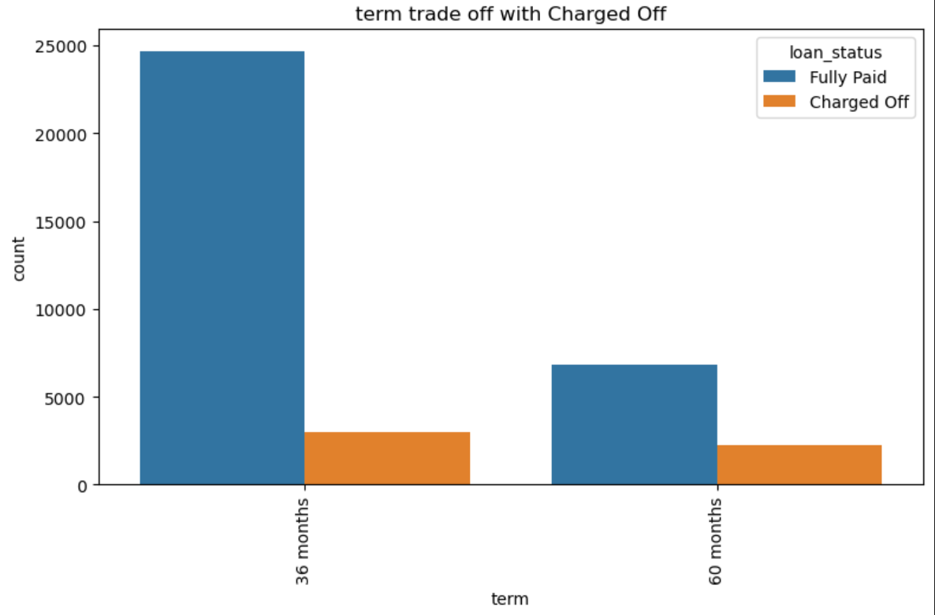
Observation:
1.The amount of credit the borrower is using relative to all available revolving credit is higher for people marked Charged Off
2.People who had taken loan of term 60 months has higher percentage of going charged off as compared to people who are taking loan for 36 month term duration, proportion of Charged Off to Total loan applications is more in case of 60 months term

Slide 17
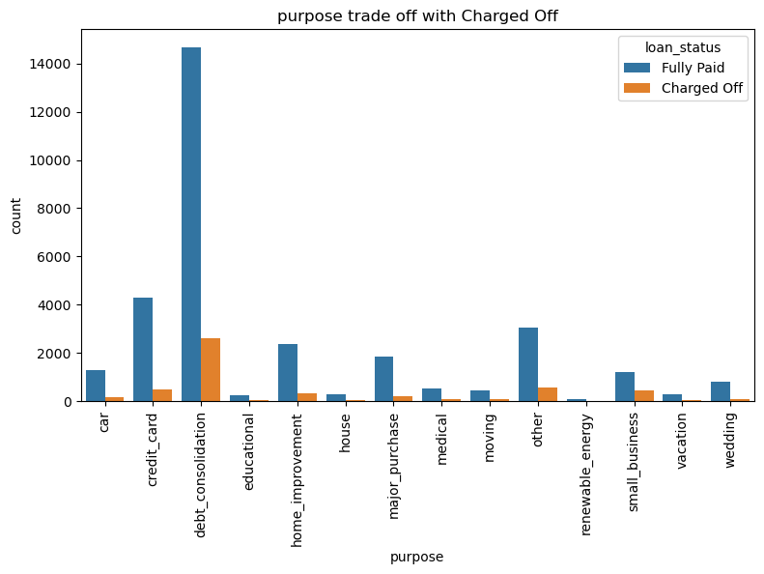
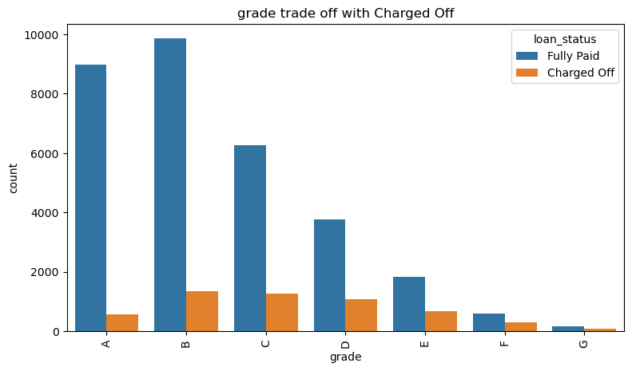
Observation:
1.Small business applicants are more likely to go charged off, proportion for Charged off to total is high
2.Grade "A" has very less chances of charged off as the proportion is lowest.
3. Grade "F" and "G" have very high chances of charged off as the proportion is higher.
4. Chances of charged off is increasing with grade moving from "A" towards "G" (Segmentation Univariate Analysis)

Slide 18
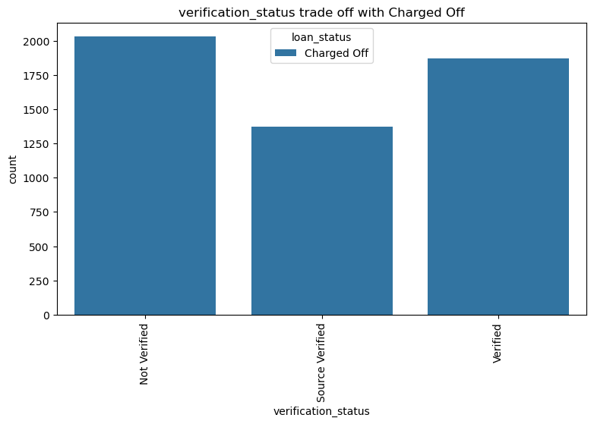
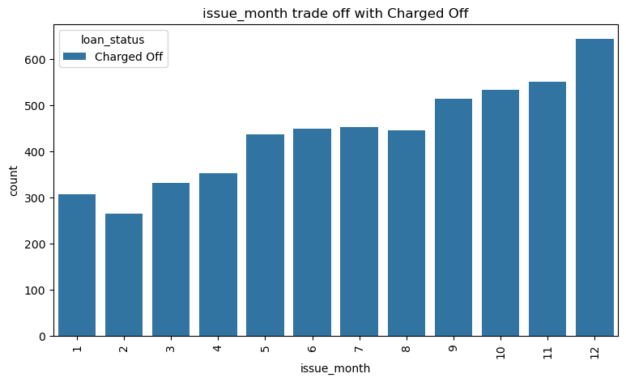
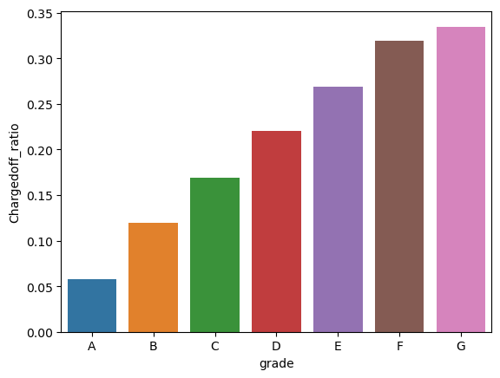
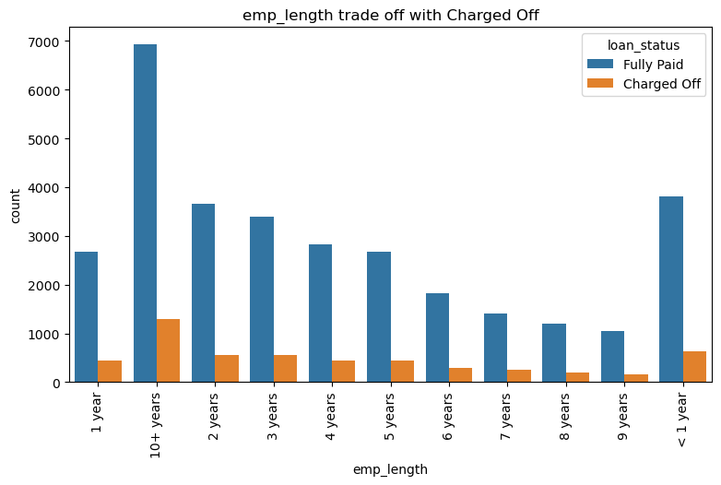
1.As observed, Charged off ratio is increasing with Grade moving from "A" towards "G", and hence grade can be used to identify the people who can default.
2.No significant trend observed in emp_length, however, ratio is slightly more for people with 10 * year of experience
3.Maximum cases of charged off are those for which applications are not verified, and it makes sense and thus it is important that verification should be done for applicants to reduce defaults
4.Most of the people who default have applied for loan on December month

Slide 19
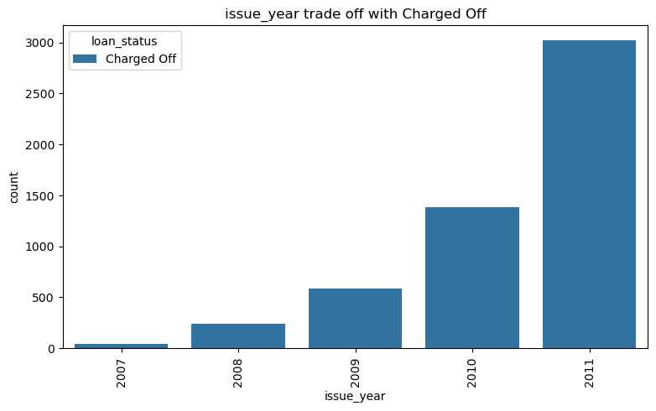
Observation: Number of applicants defaulting is increasing year over year linearly

Slide 20
Multivariate Analysis Following fields seems to impact loan status field: 1. Grade 2. loan_amount 3. int_rate 4. purpose 5. Year of issued application 6. total_rec_late_fee 7. verification_status 8. annual_inc

Slide 21
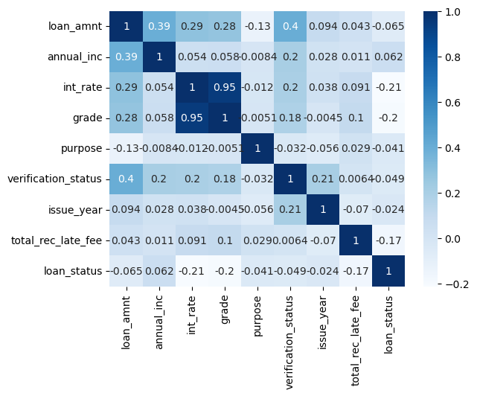
Observations:
1. There is high correlation between Grade and interest rate
2. There is negative correlation between all features and loan status field, i.e., loan status moved towards 0 state (Charged Off) for higher values of loan amount, annual inc, interest rate, purpose (small business), issue year, late fees, which we have already observed in previous analytical charts

Slide 22
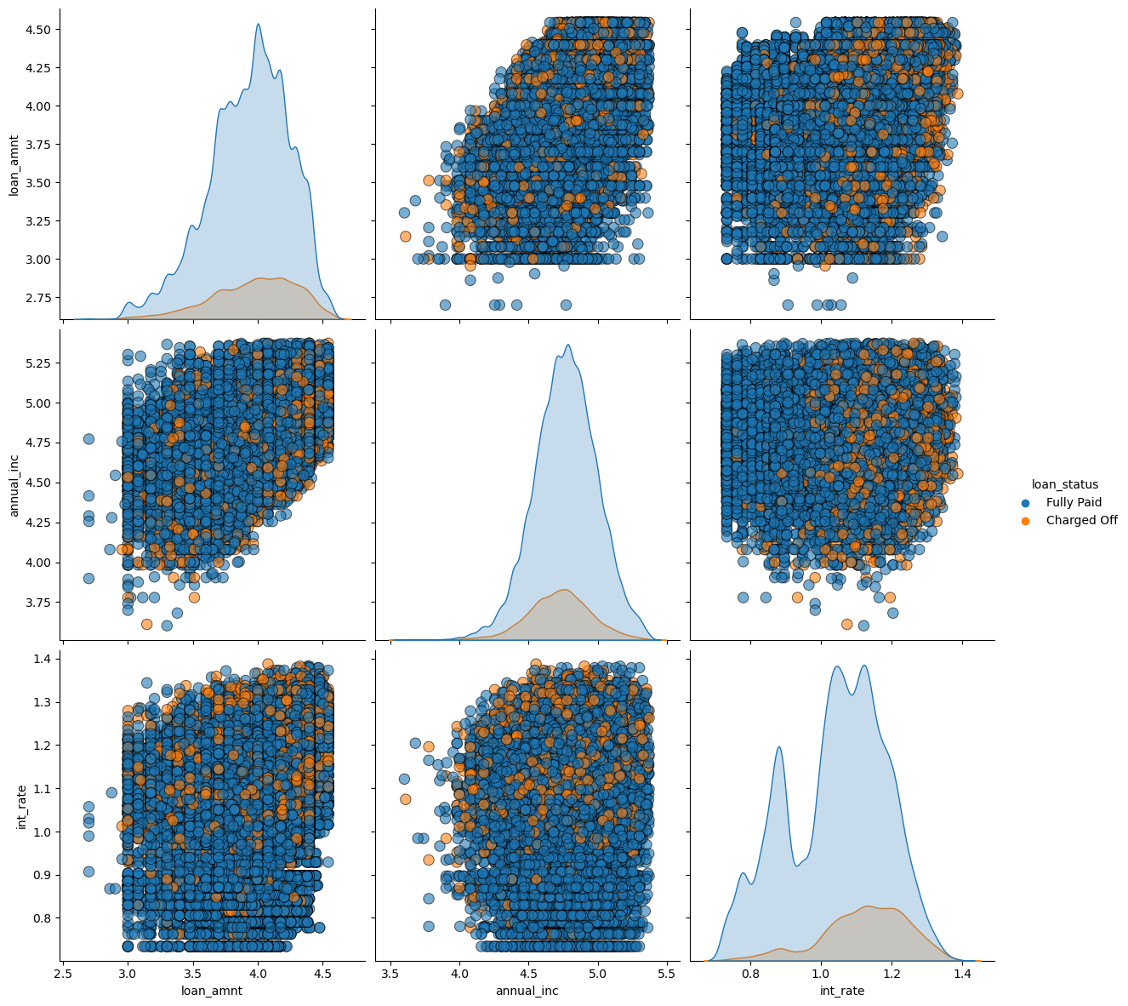
Pair plot for multivariate
Observation: Same trends can be observed with pair plots

Slide 23
Summary
As per the exploratory data analysis below are key takeaways:
1. Higher the interest rate higher charged off ratio
2. Higher the annual income higher the loan amount slightly.
3. Intrest rate is increasing with loan amount increase
4. Number of people defaulting is increasing every year
5. People paying more late fees are more likely to default., i.e., if they are regulating delaying monthly payments for loan, more likely they are undergoing monetary crunch and are likely to default
6. People taking loan for small business are more likely to default
7. People whose verification is pending are more likely to default

Slide 24
THANK YOU
Astha Agarwal
Vinay Prasad
Astha
Vinayprasadk1990@gmail.com

